Slide 1
Big Time Ballers
Predicting the 2017 All-NBA Roster
Danny Arenson
06/15/17

Slide 2
Introduction
NBA Season is a grueling stretch of 82 games (minimum) spanning over 6 months
Also allows the best players in the world the chance to display their skills and talents on the highest level
At the end of the season the NBA awards its players with various types of honors
Ex) MVP, All-Defense, Sixth Man, Most Improved, All-NBA

Slide 3
“The All-NBA Team”, What Does This Mean???
All NBA Team is an award given at the end of the season to the best players in the NBA. Consisting of the theoretical best “Starting 5 roster”
Ie) If I wanted to make the best team of players, it would be….
Success is typically valued on a team scale, but in this case, making the All-NBA Team is based solely on individual performance throughout the season.
Besides for winning the NBA “MVP” (Most Valuable Player, given to only one individual in the entire league), making the All-NBA team is considered to be the highest award for the “best of the best”.

Slide 4
Who votes for players to make the All-NBA Roster?
The Associated Press (AP)
Experts in the field of Journalism, but not so much when it comes to statistics and numerical data to back their choices.
Roster spots are voted one player for each position: Point Guard, Shooting Guard, Small Forward, Power Forward, Center
3 Tiers of All-NBA Teams: All-NBA First Team, All-NBA Second Team, All-NBA Third Team (15 players total)
Equivalent to Gold, Silver, Bronze)

Slide 5
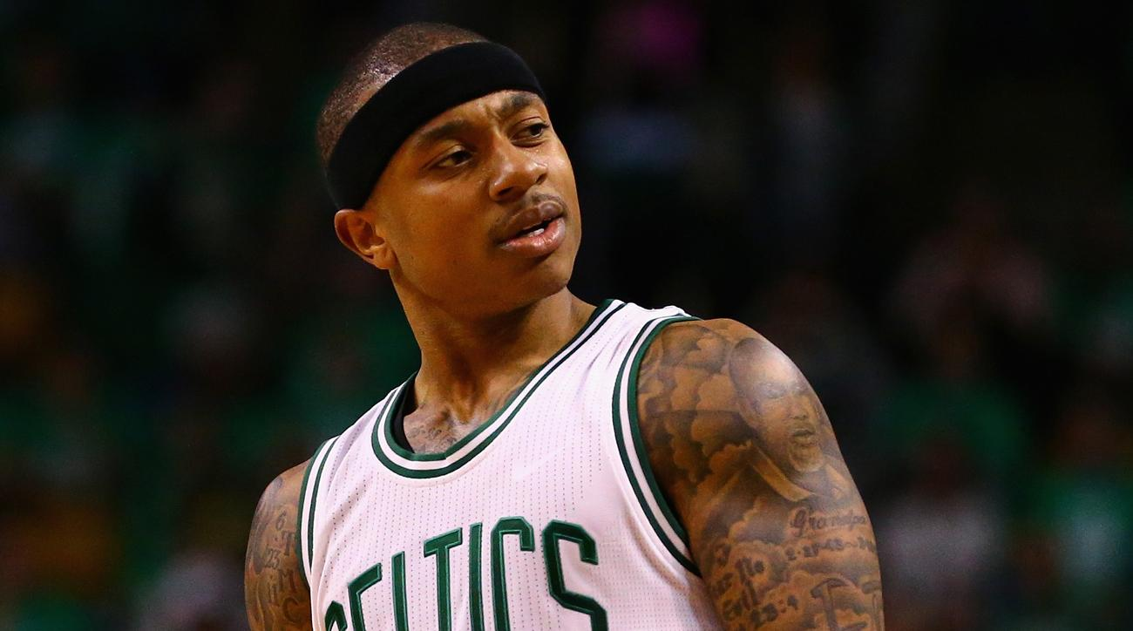
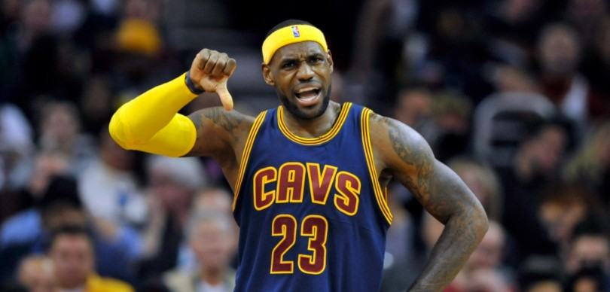

The Problem:
As avid NBA fans, we see over the years that although many of our favorite players get elected into the All-NBA roster, some however still get snubbed even though deserve it
This can make or break a career at the end of the season, and possibly prevent a player from making millions of dollars in contract negotiations, free agency, and/or bonuses.

Slide 6
The Problem cont…
Along with championships, all-star appearances and MVP award, this honor plays a critical role when being considered for the Hall of Fame at the end of players career
One of the highest accolades to build on for an NBA resume

Slide 7
Data / Methods
Data:
NBA Player data was collected from 2000-2017
7300 Players with 89 variables collected
Methods:
The data was preprocessed using Python scripts to collect JSON data and converted to CSV format
17 csv files combined with concat command in python

Slide 8
The Approach
The Following Topics that I covered:
Classification Model to determine what “classifies a player to be of All-NBA status
Cluster Analysis methods incorporated into the dataset
Adding 2 types of Rating called the “Playmaker” and “Scorer” Ratings to predict All-NBA players based on efficiency
Regression Analysis on the dataset
Analyzing the accuracy of the Playmaker and Scorer Ratings to previous All-NBA Rosters

Slide 9
Method 1: Classification Accuracy
Imported Scikit_learn packages into Python
Converted classifiers into binary model
Split into two pieces for train and test dataset to make any further predictions.
Computed Scikit_learn Accuracy Model and received a score of 97%
Null Accuracy for multi-class classification ~93% Accuracy

Slide 10
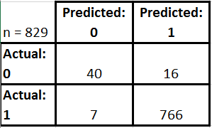
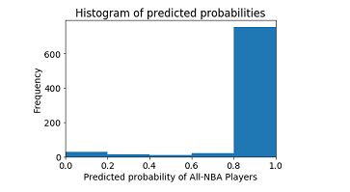
Method 1: Classification Accuracy:
Confusion Matrix
To describe performance of the classification model I designed a Confusion Matrix on Python
Question: How are the metrics computed from a confusion Matrix?
Answer:
Sliced into four pieces (TP, TN, FP, FN)
Classification Accuracy on dataset: ~97%
True Positive: 99%
False Positive: 29%
Specificity: 71%
Precision: 98%

Slide 11
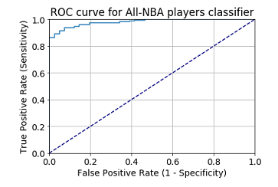

Method 1: Classification Accuracy:
(Indicative of a good classier, located in the top left corner)
ROC Curve:
Performed an ROC curve on data to illustrate classifier performance
“Hugs” the upper left corner. Meaning, this Classifier is doing a good job at separating the classes
You can’t actually see the thresholds used to generate the curve on an ROC curve itself
To better understand I needed to evaluate threshold through Sensitivity and Specificity
Received scores .99 and .71, respectively
Area Under the Curve:
Useful as a single number summary of classifier performance.
Received score 98%

Slide 12
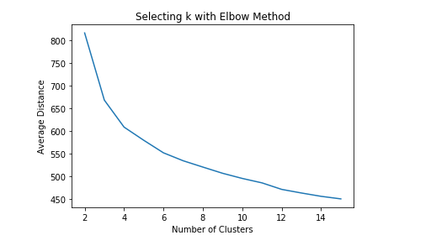
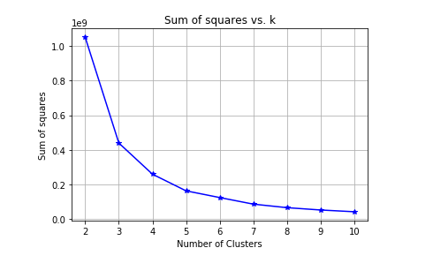
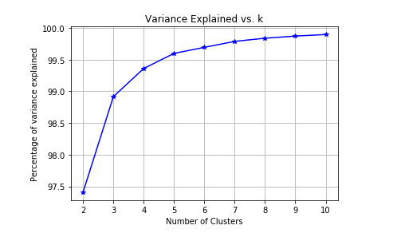
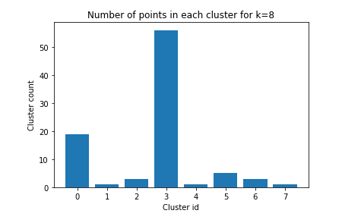
Method 2: Cluster Analysis
Examined patterns and trends in data with:
Elbow Method
Silhouette Method
K-Means Clustering
Various Methods to establish what is the most ideal value of clusters in the dataset
Ideal K = 3

Slide 13
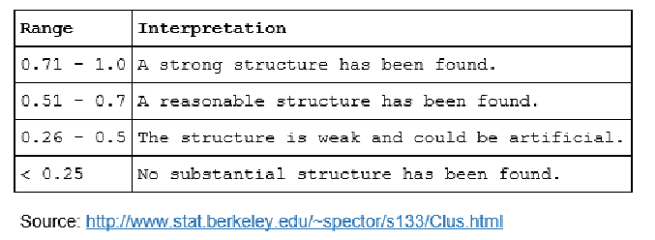
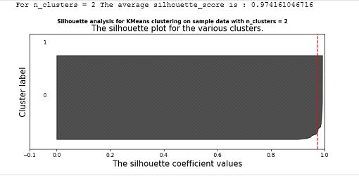
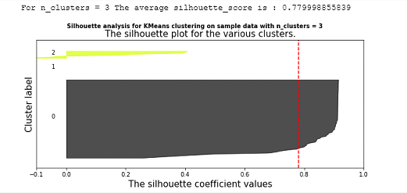
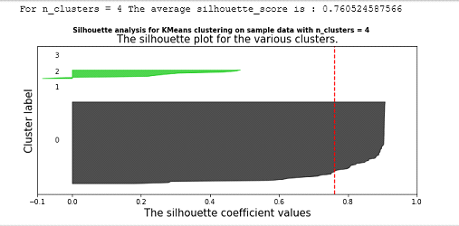
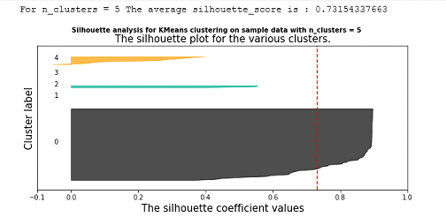
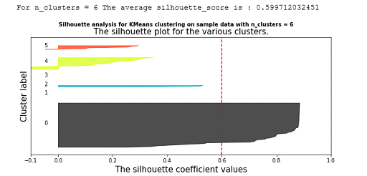
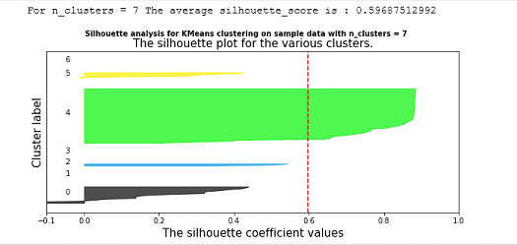
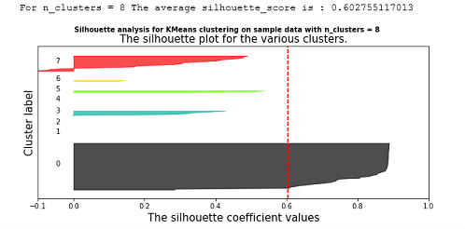
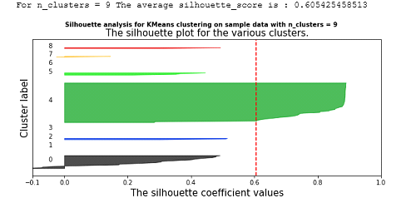
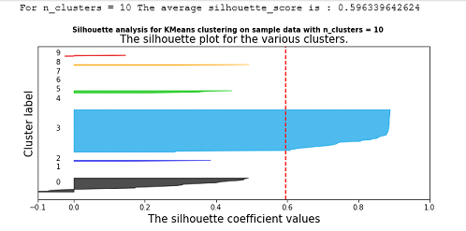
Method 2: Cluster Analysis
Silhouette Plots:
Based on n_clusters, 2 would be the ideal K Means Clustering Model

Slide 14
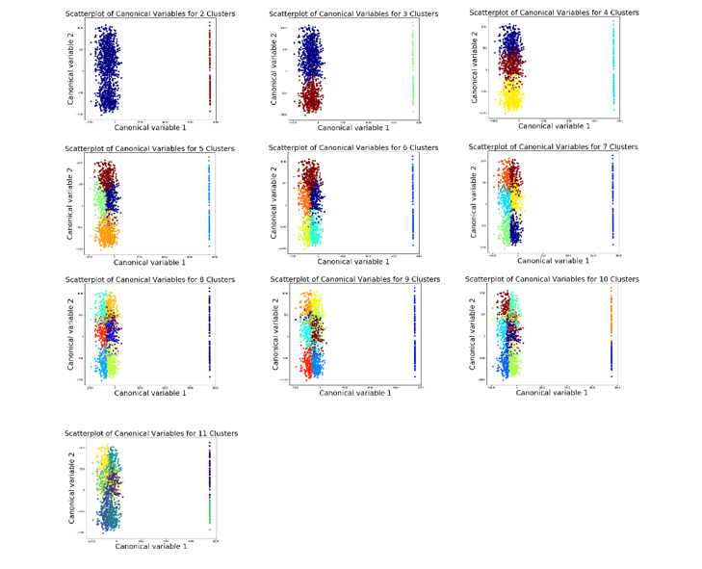
Method 2:
Cluster Analysis
Principal Component Analysis (PCA):
Clearest grouping of clusters appear with 6, 7

Slide 15
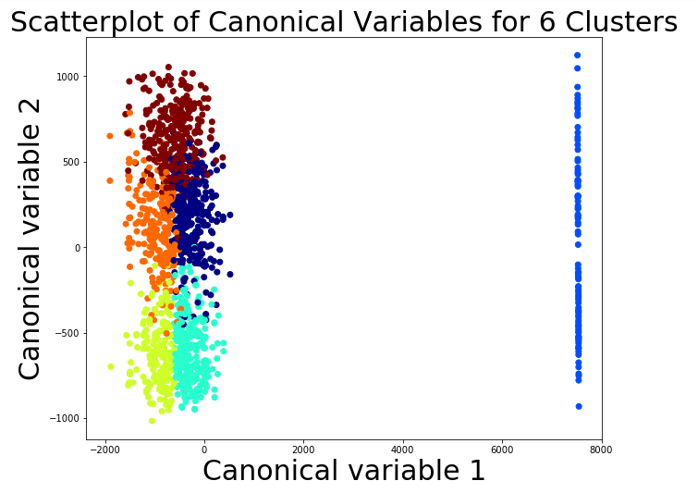
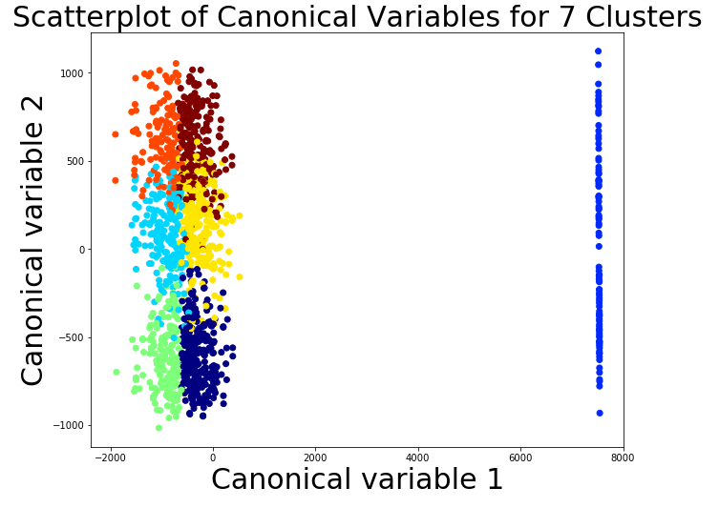

Slide 16
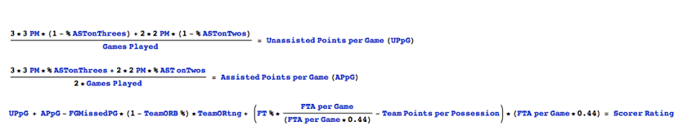
Method 3: Creating a Playmaker and Scorer Rating
Scorer Rating highlights scoring points in respect to player performance in adding to the team
Playmaker Rating highlights overall efficiency in “playmaking” abilities
Scoring, Assists, Turnovers, etc..

Slide 17
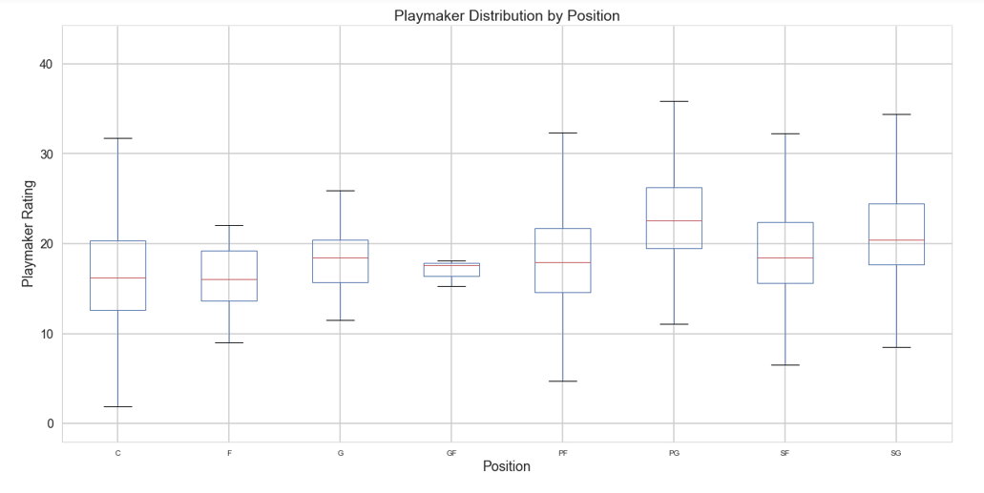
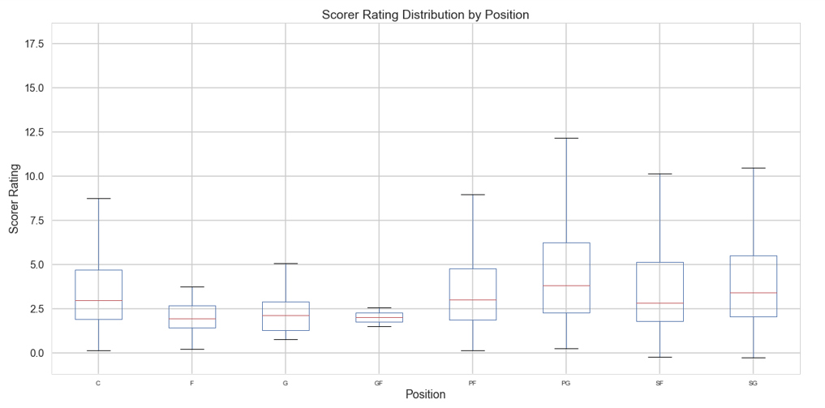
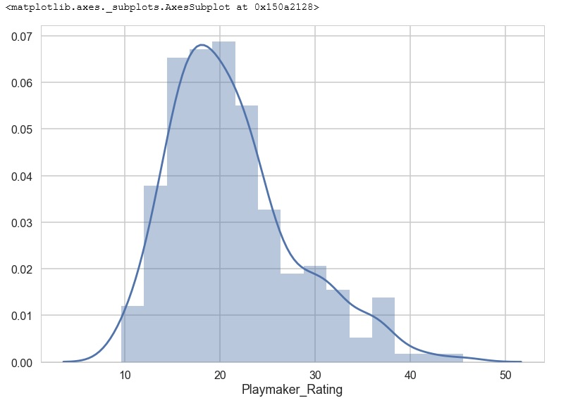
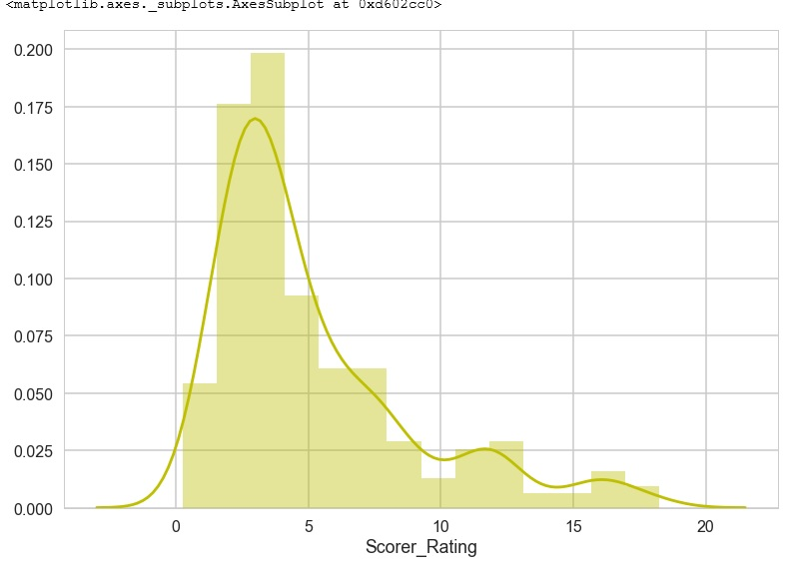
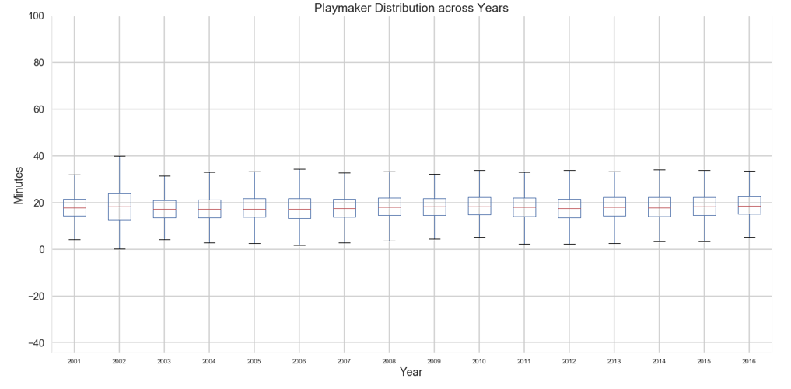
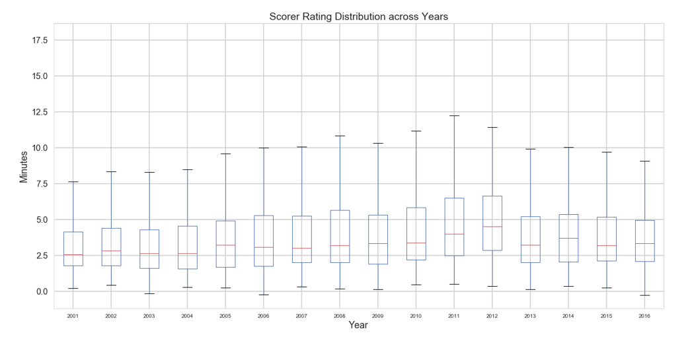
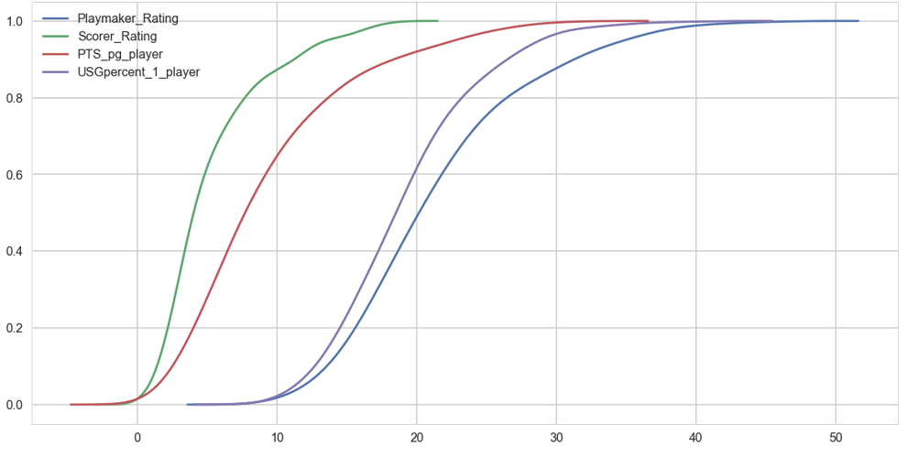
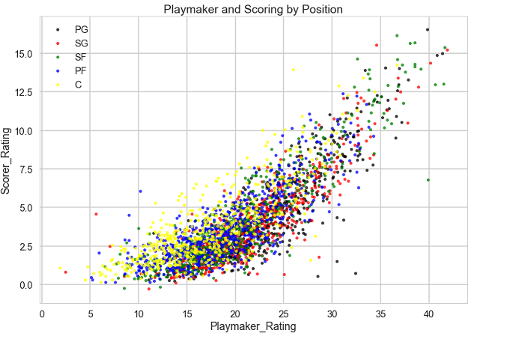
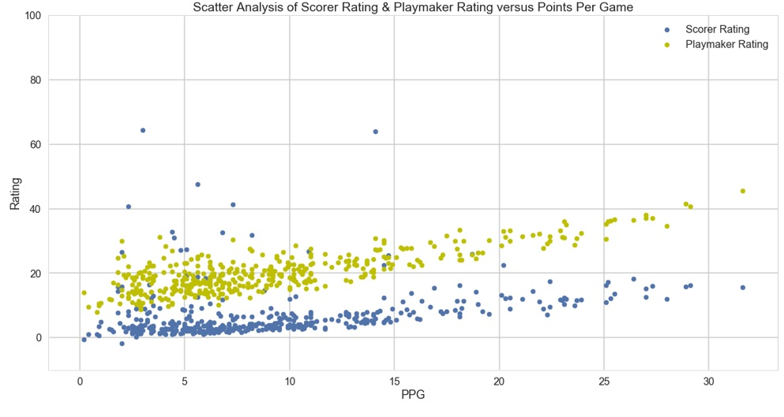
Exploratory Analysis with implementation of the Playmaker and Scorer Ratings

Slide 18
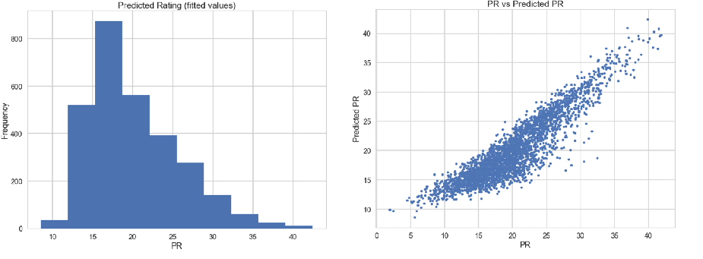
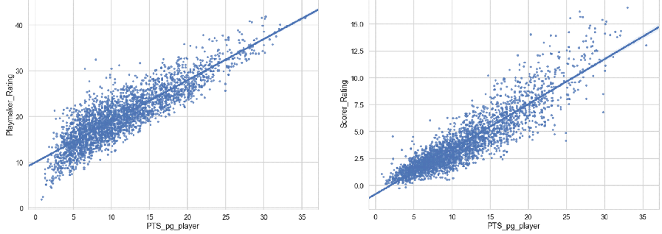
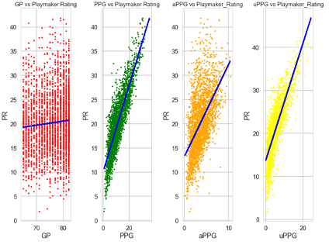
Regression
Linear Regression:
Correlation between points per game vs Playmaker Rating
Correlation between points per game vs Playmaker Rating
Correlation between Games Played, Points Per Game, Assisted Points Per Game, Unassisted Points Per Game vs. Playmaker Rating
All Display Positive Relationship

Slide 19
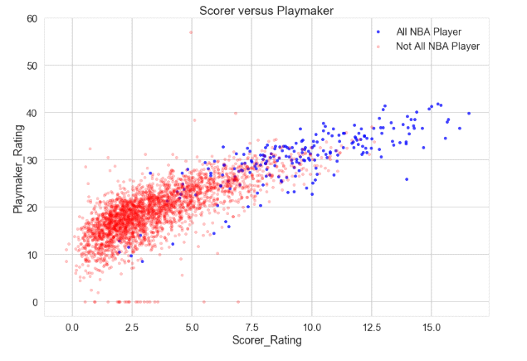
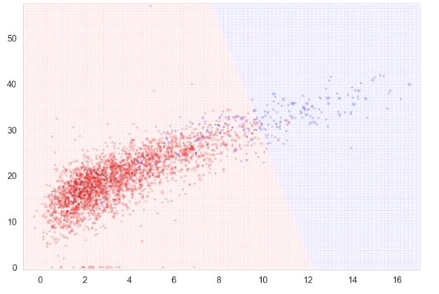
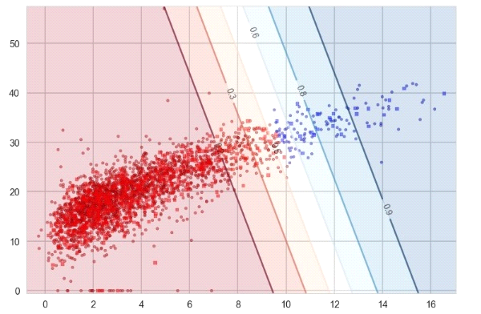
Regression
Logistic Regression:
Binary Classifier
Decision Boundary separating both classes

Slide 20
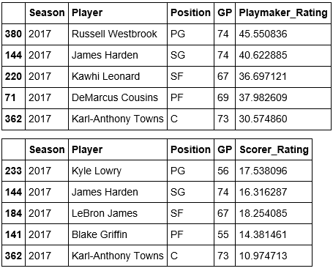
And the 2017 All-NBA team is…

Slide 21
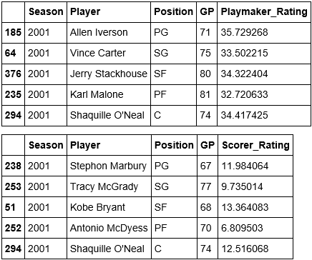
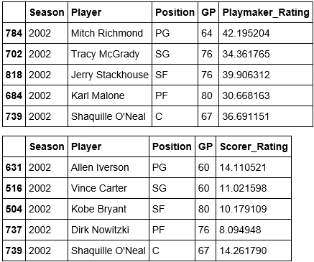
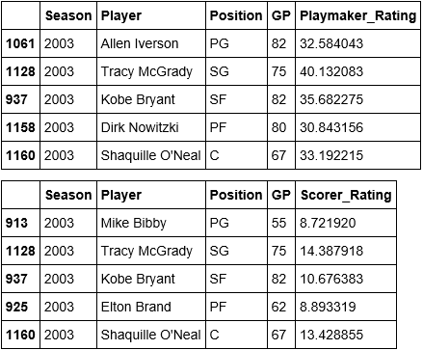
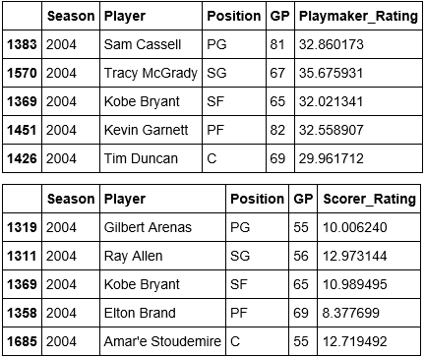
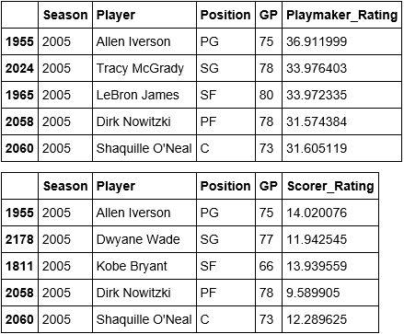
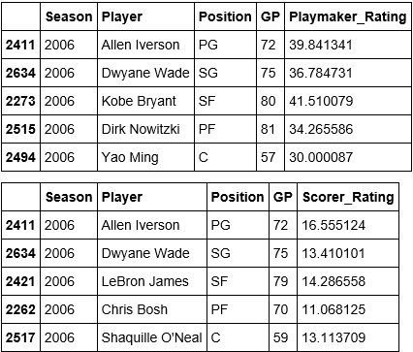
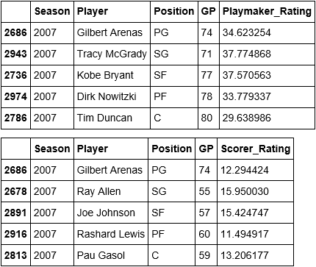
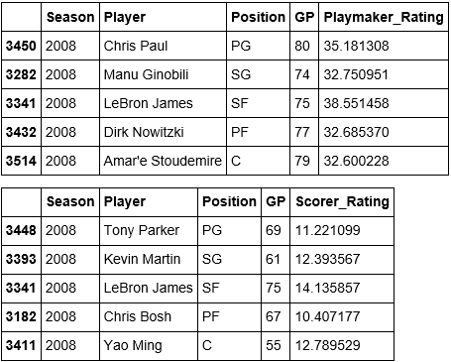
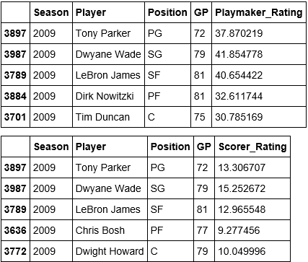
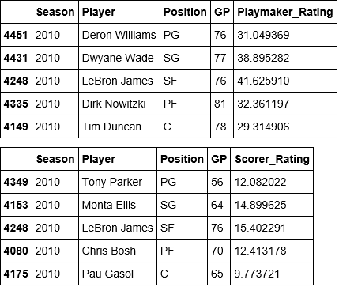
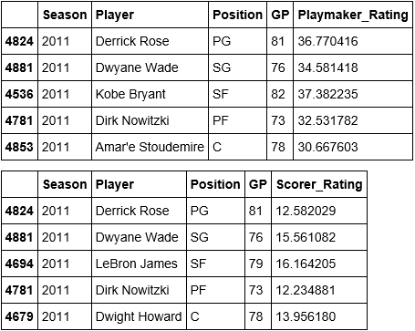





Comparing the “theoretical” vs. “actual” across the years

Slide 22




Comparing the “theoretical” vs. “actual” across the years cont…
Wide range of overlap between 1st 2nd 3rd teams and Playmaker and Scorer Rating Starters

Slide 23
Proposed use of Rating
The Playmaker and Scorer Ratings could come in handy when playing various fantasy sports betting websites ie) Draftkings, FanDuel. Better results = more $$$
Associated Press use these metrics when voting for All-NBA rosters. This would provide substantial numerical evidence to back up their choices and eliminate any biases.

Slide 24
Advantages of New Rating System
Levels the playing field in selecting players based solely on personal stats and not notoriety or fandom
Provides a more effective way to evaluate a players efficiency and involvement on the court
Could be a useful metric for each teams scouting department and general manager

Slide 25
Proposed next steps
Improve the Rating System:
“Playmaker” is an all-around weighted evaluation of a player. “Scorer” evaluates player performance based strictly on offensive talents. Both very critical in evaluating the best of the best, but can highlight many different players.
Compute a universal hybrid rating that highlights both ratings as an indicator of performance
Instead of focusing on the basic individual in-game stat line of ppg, apg, rpg, etc… the various websites that track real-time stats of games would highlight these ratings instead.

Slide 26

Thank you!

